Slide 1

BroadbandUSA Connectivity Assessment Tool - Overview
Summer 2017
Laura Spining | Karen Archer Perry

Slide 2
Outline
NTIA Update
Partner comments
Beta operations
Q and A
Values
Leverage
Learn
Deliver
Progress

Slide 3
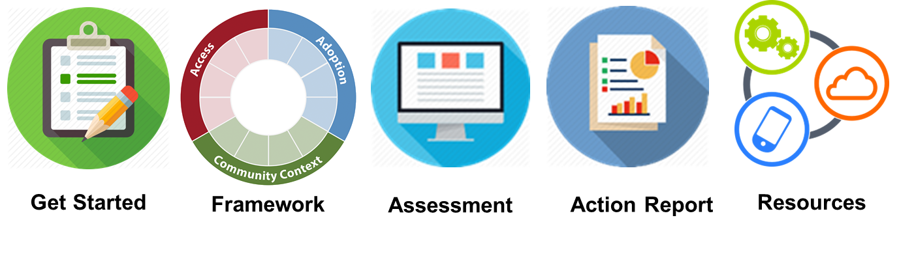
Vision
Accelerate community broadband planning, action, and progress.
  Better outcomes in less time
  Engage more communities
  Increase resource relevance & usability
Advance broadband access, improve adoption, strengthen policies

Slide 4
BroadbandUSA Connectivity Assessment Tool
Process
800+ stakeholders consulted
12 measurement programs incorporated
Result
Community Connectivity Framework
Online assessment tool
Value
Structured Planning
Support for action
8 systems change models reviewed
Platform for additional tools
Flexible path
Collaboration tool
National data

Slide 5
Broadband is important to my community* because …
Economic development
Work at home
Attracting businesses
Business diversification
Real estate value
Seasonable rental
Expanding the season
Internet is a rental requirement
Public safety
Aging in place
Broadband is an expectation – including speed and reliability
Attracting young families
School work and education
Community sustainability
Connecting communities to each other
For island communities, broadband is comparable to the ferry
Keeping up with other communities
*Maine Community Workshop January 2017
“The problem is that we are good enough and good enough isn’t going to be good enough any more.”

Slide 6
In order to improve broadband in our community, we need...
Open and creative approach to creating partnerships
Public private partners will crack the code
Reframe the conversation. Broadband IS infrastructure and requires investment
More, faster, cheaper, and reliable
Increased education and awareness
Information, facts and option
Lower cost solutions – e.g. fiber and wireless
Help building better business cases; how do we shift the economics
Leverage school and library connections to reach homes and businesses
Help reaching small population areas
*Maine Community Workshop January 2017
“A high fiber diet is healthy for the community.”

Slide 7
Co-Design Principles – What we have heard from you.
Encourage robust conversations
Fall to local
Bias for action
Go deep
Support flexible paths
Facilitate partnership
Encourage continuous improvement
Surface relevant resources

Slide 8
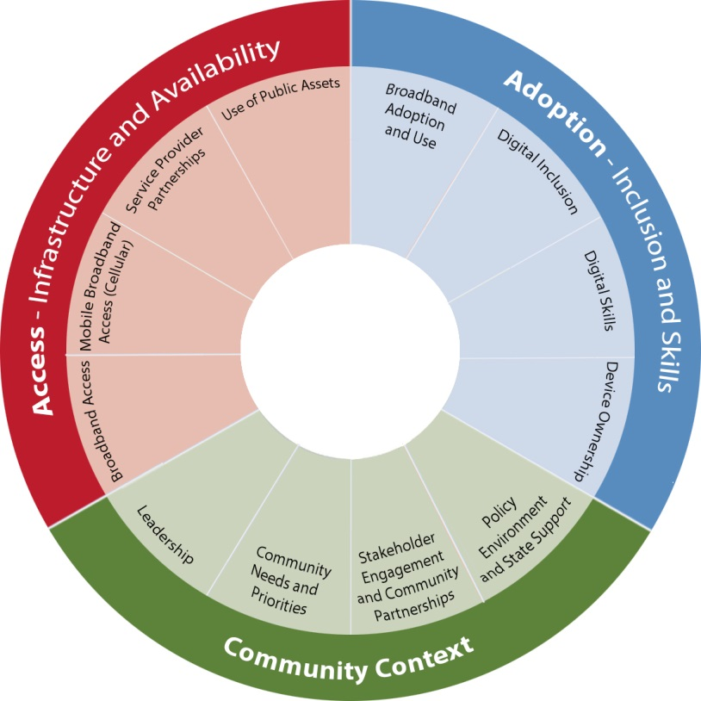
BroadbandUSA Connectivity Assessment Tool
Three sectors
12 modules
~160 questions
Localized data from U.S Census, NTIA Digital Nation, FCC 477
Action reports
Recommended resources

Slide 9
Access – Broadband Infrastructure and Availability
Broadband Access: What wireline and fixed wireless broadband services are available in your area?
Mobile Access: What cellular coverage and technology is available in your area?
Provider Engagement: Are there opportunities to further strengthen partnerships with existing and new service providers?
Public Assets: How do local policies support the use of public assets, enhance advanced telecommunications, and serve the public good?

Slide 10
Adoption – Digital Inclusion and Workforce Skills
Adoption and Use: Who is using the Internet? Are there digital divides?
Digital Inclusion: What proactive measures are you taking to ensure digital equity?
Digital Skills: Do programs provide a ladder for residents to gain digital proficiencies - from basics to coding?
Devices: Do people have access to the devices they need to learn, create and participate?

Slide 11
Community – Leadership and Context
Leadership: Who are the broadband champions in your locality?
Community Priorities: What issues draw us to take action to improve broadband?
Stakeholder Engagement: How are you engaging stakeholders that can bring interest, influence, or support to local broadband initiatives?
Policy Environment: Are there regional or state resources or regulations that impact local planning and investment?

Slide 12
What you’ll Find in Each Module
Assessment Scope
National data
Prompts
Responses (local insights)
Team responses
Summary reports
Resource recommendations*
*under development
Types of Prompts
Informational
Scale
Scope
Narrative
Links to local resources
Links to share
Plus a few others…

Slide 13
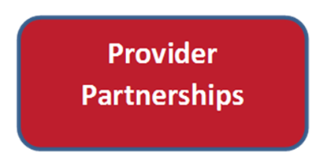
What’s in a Module?
Data: Providers offering residential broadband services in locality
Data: Providers offering business broadband services in locality
Provider contacts and relationships
Demand projections and aggregation
Provider deployment plans
Service provider agreements
Partnership engagement self-assessment
Partnership engagement narrative
Partnership engagement links and resources
Are there opportunities to further strengthen partnerships with existing or new service providers?

Slide 14
You are the Driver
Complete planning process on your own schedule
Identify your team members; updates are okay
Select modules to complete
Answer all questions; skip around; select scale only
Individual responses and team responses are preserved
Responses can be changed
Note: Report recommendations links are under development

Slide 15
Target Audience: Broadband Planning Teams
Geographic communities of all types that want to improve community connectivity and digital equity
Elected official
City/county manager
IT manager or staff
Nonprofit or Government Inclusion Champion
Citizen advocate or business leaders
Tribal leader or IT champion
Consumer or business owner
Internet service provider

Slide 16
User Roles
Team Lead
  Can edit team responses; can edit and publish their own responses; can read published and team responses. Serves as the primary point of contact to NTIA.
Team Editor
  Can edit team responses; can edit and publish their own responses; can read published and team responses.
Team Contributor
  Can edit and publish their own responses; can read published and team responses.
Community Participant
  Can only read published and team responses.

Slide 17
Beta Test Objective and Scope
  Evaluation Scope
  User flow and process
  Assessment questions and responses
  Ease of use
  Administrative functions incl. user roles
  Training and support needs
  Recommended resources
  Reports and downloads
  Framework language and structure
  Benefit and “burden hours”
  Areas for improvement
  Additional planning support; what other tools can BBUSA create to reduce planning cost
Objectives
Deliver online planning tool
Provide localized views of national data
Test assumptions and improve
Capture feedback to inform future work
Identify additional opportunities to support local leaders
Provide wrap-around services

Slide 18
Thank you beta test communities and partners!
15 communities; 12 users per community; 3 month beta period
AL
Alexander City
WA
ME
Selma
Stevens Co
Lincoln Co
White Center, King Co
Piscataquis
Lincoln Co
Long Island
NCC / NDIA
Charlotte NC
San Antonio TX
Louisville KY
Kansas City MO
Vinalhaven
Swan’s Island
Franklin Co
Partners: ConnectME, Washington State CIO’s Office, Washington State Extension Services, Next Century Cities, National Digital Inclusion Alliance

Slide 19
For More Information
The BroadbandUSA Connectivity Assessment Tool is the first tool in a suite of tools that NTIA BroadbandUSA is creating to support broadband and economic development.
Email BroadbandUSA@ntia.doc.gov or call or write:
  Laura Spining LSpining@ntia.doc.gov (202) 482-5637
  Karen Perry KPerry@ntia.doc.gov (206) 861-6043

